Slide 1
BIGHERO5
Gautam Ravichandran | Karankumar Parikh | Ashwin Nair | Victoria Green | Young Jun Son

Slide 2
About Us

Slide 3

The Team
Gautam Ravichandran
Karankumar Parikh
Ashwin Nair
Victoria Green
Young Jun Son
Team Coordinator
Java Coder
Front-End Developer Documents Handler
Java Coder Database Manager Backend Developer Documentation
Presentation
QA Analyst Documentation
Java Coder
Java Coder Database Manager GUI Coder/Tester Documentation
Java Coder Documentation
User Guide
QA Analyst

Slide 4
Overview
Purpose: Develop an efficient tool to manage and automate everyday tasks seen in hospitals.
Intuitive
Secure
Reusable
All-In-One

Slide 5
Main Features
Feature 1
Scheduling Appointments
Feature 2
Maintaining Patient Records
Feature 3
Overseeing Pharmacy Inventory
Feature 4
Processing Patient Invoices

Slide 6
Special Feature
Multithreading
new Thread(new Runnable(){
public void run(){
while(true){
try{
Thread.sleep(1000);}
catch(Exception e){}
jl.setIcon(new ImageIcon("E://images//"+im[i]+".jpg"));
i++;
if((i==im.length)){
i=0;}
try{Thread.sleep(2000)}
catch(Exception e){}
}}}).start();

Slide 7
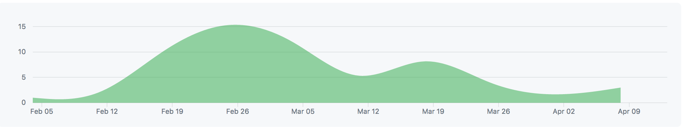
Timeline and Metrics
January | February | March | April
 |  | Implementation
Planning
Code: ~3,000 Lines
Final Report: 30 Pages
Implementation
Finalize

Slide 8

Developmental Tools
Code: Java
GUI: Swing
Database: SQLite
Repository: eGit
IDE : Eclipse

Slide 9
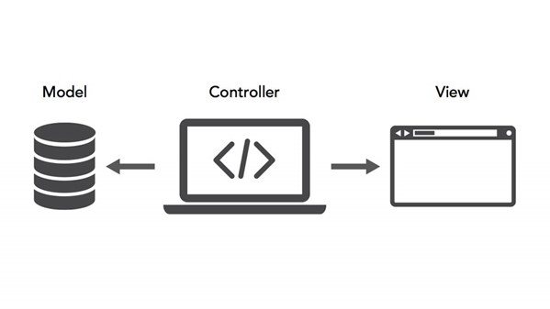
System Model
HMS System Modelling
Our Hospital Management System is conducted in a client-server architecture.
The user’s inputs and actions within the application interact with the server/database as each event either provides access, creates, updates, or deletes content from the server.
The application utilizes a Model-View-Controller architectural structure. In this model, the model is continuously updated by actions conducted by the user and displayed soon after to the user.

Slide 10
Use Cases and Sequence Diagrams

Slide 11
Use Case

Slide 12
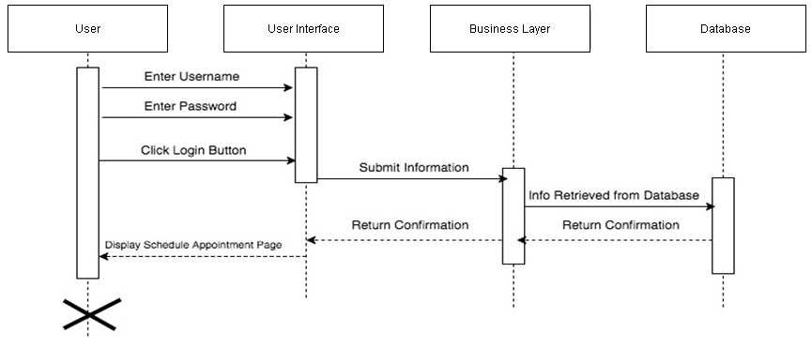
Sequence Diagram: Login
Item 2
Item 3

Slide 13
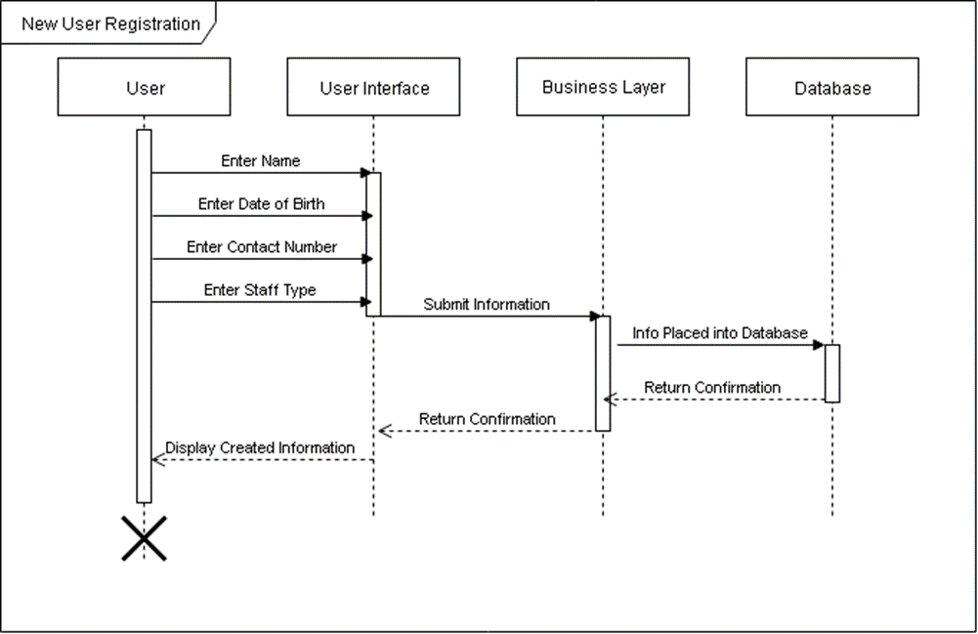
Sequence Diagram: New User Registration

Slide 14
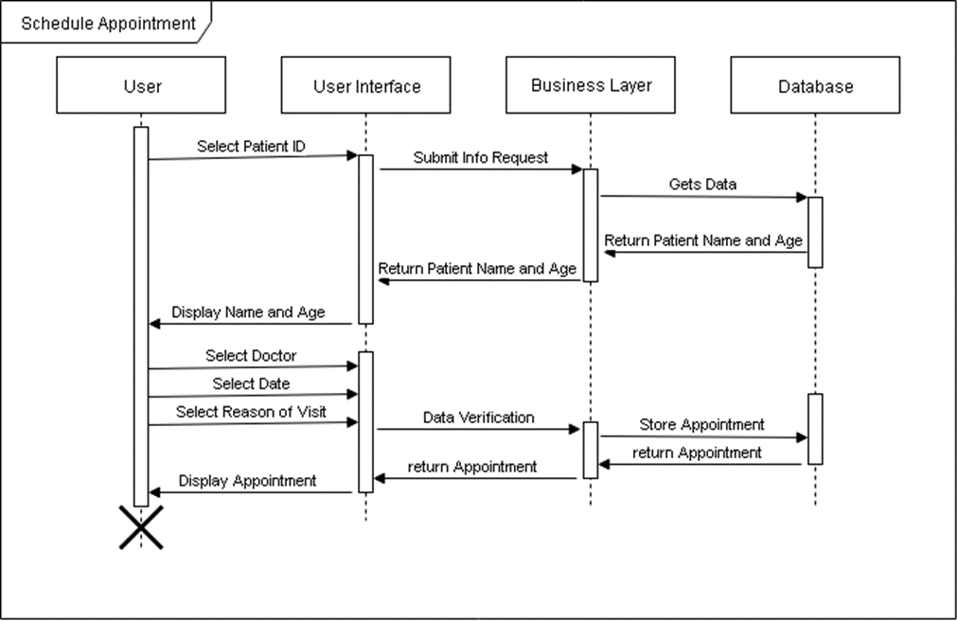
Sequence Diagram: Schedule Appointment

Slide 15
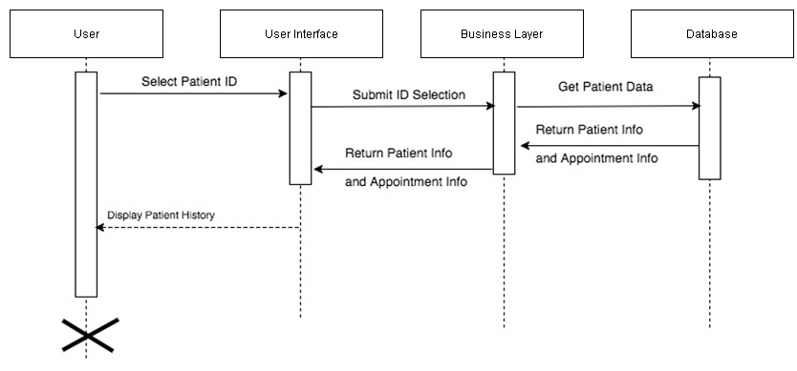
Sequence Diagram: Patient History

Slide 16
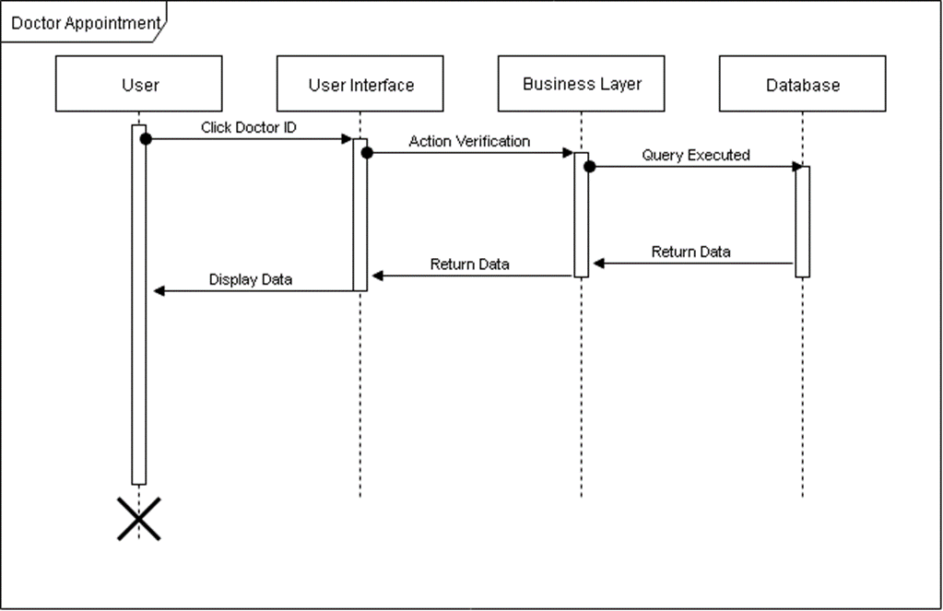
Sequence Diagram: Doctor Appointment
Item 2
Item 3

Slide 17
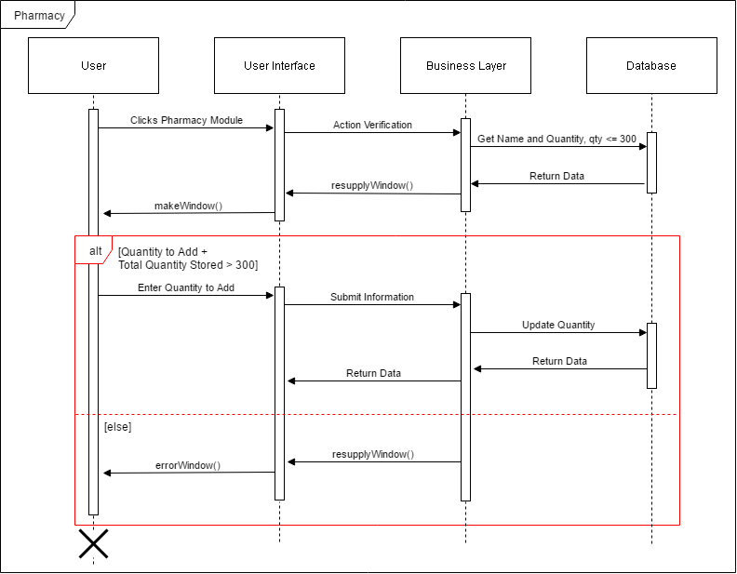
Sequence Diagram: Pharmacy
Item 2
Item 3

Slide 18
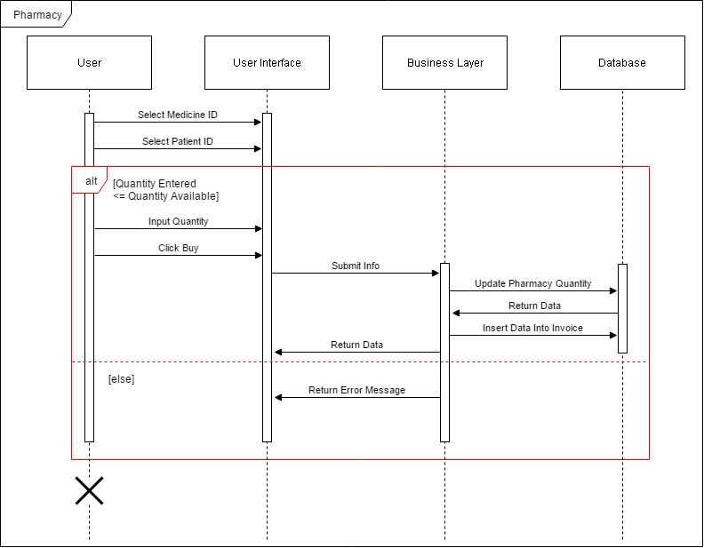
Sequence Diagram: Pharmacy
Item 2
Item 3

Slide 19
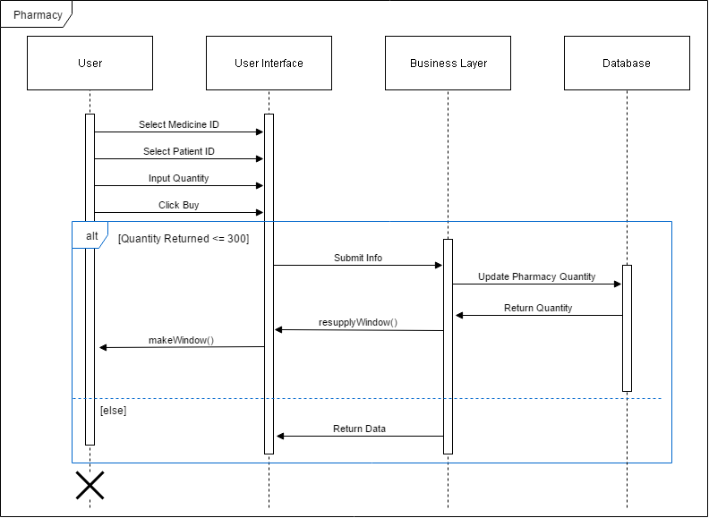
Sequence Diagram: Pharmacy
Item 2
Item 3

Slide 20
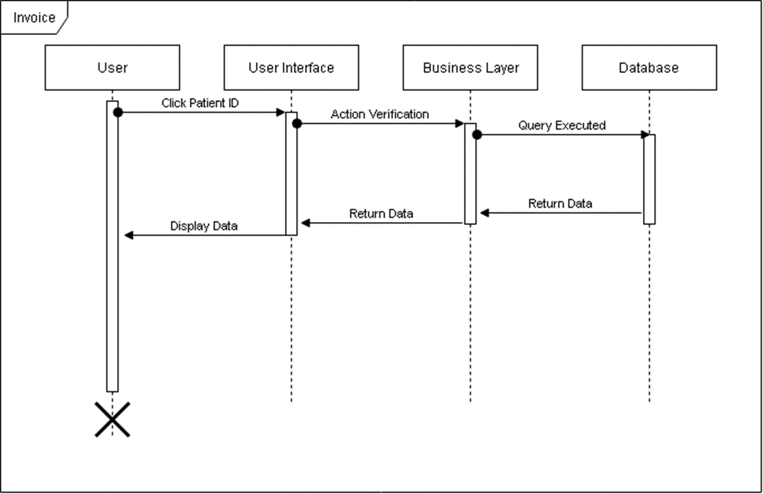
Sequence Diagram: Invoice

Slide 21
Demonstration

Slide 22
Summary
We have created an easy-to-use, multi-user software which demonstrated the following:
Relevant functionality
Comprehensive GUI
Database manipulation
Group productivity

